Slide 1
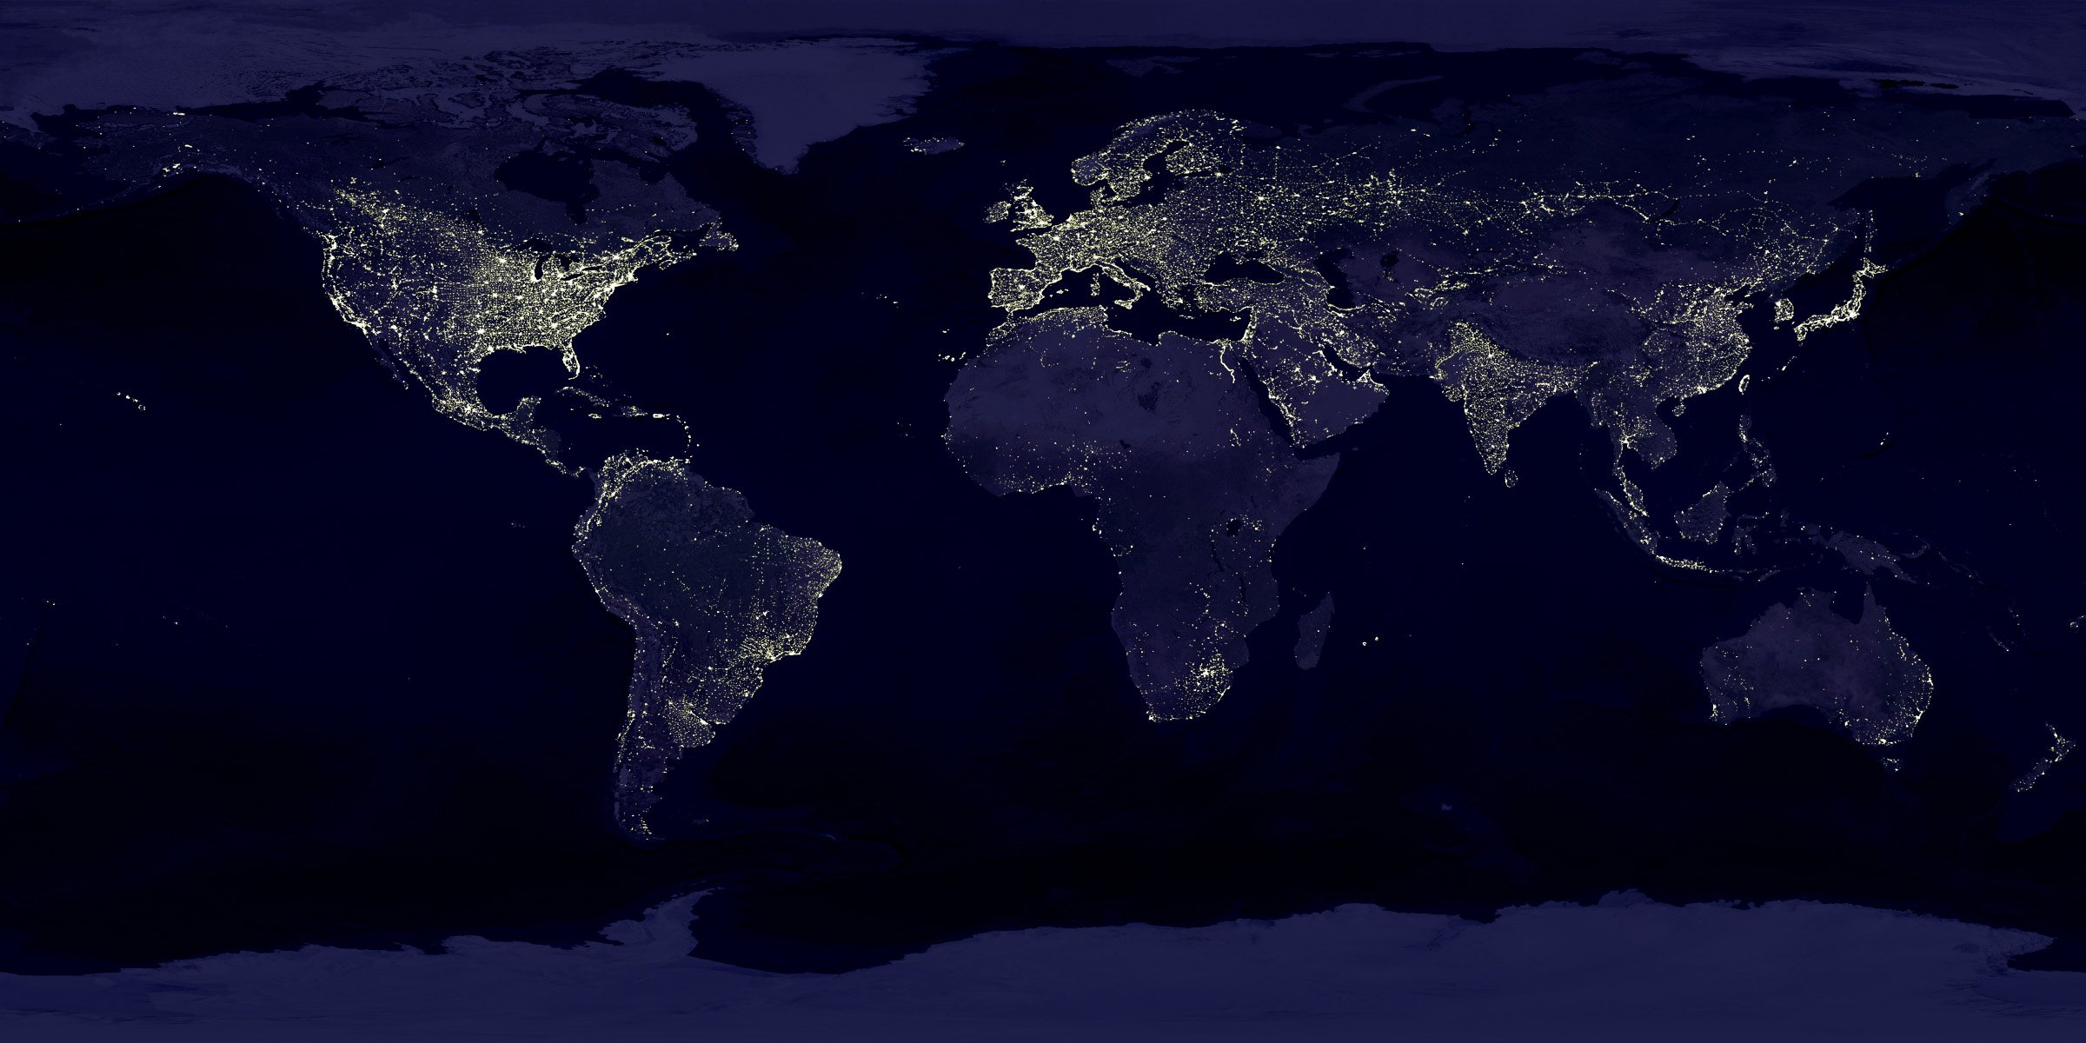
Global Life Expectancy Analysis
Group 5
Arda Cankat Bati
Qingyuan Jin
Weinan Li
Wei Zhang

Slide 2

OUTLINE
Introduction
Dataset Overview
Motivation
Differences between countries
Relevance Analysis
Change through years
Conclusion
Conclusion

Slide 3

Introduction

Slide 4

Introduction
Life Expectancy: The average period that a person may expect to live.
Problem: affected by too many variables
Harder to analyse for individuals, more
predictable for groups
Selecting variables that apply in general is
the key

Slide 5

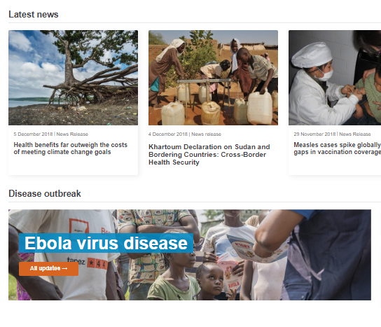
Dataset
Dataset taken from kaggle.com
Generated from the World Health Organization website
193 countries, 21 Features, between 2000 – 2015
Features: Economical, Physical, Diseases etc.
Some incomplete points, required more cleaning than normal

Slide 6

Motivation

Slide 7
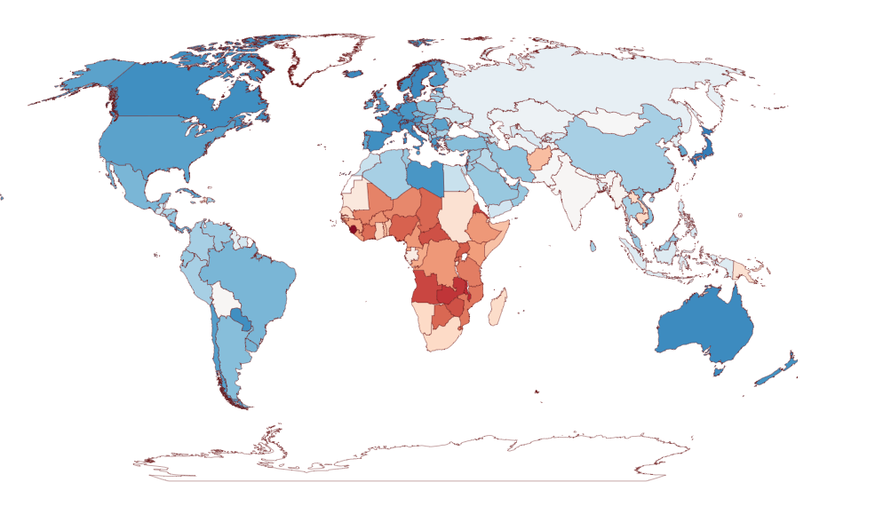
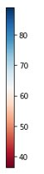
Life Expectancy in the year 2000
in years

Slide 8
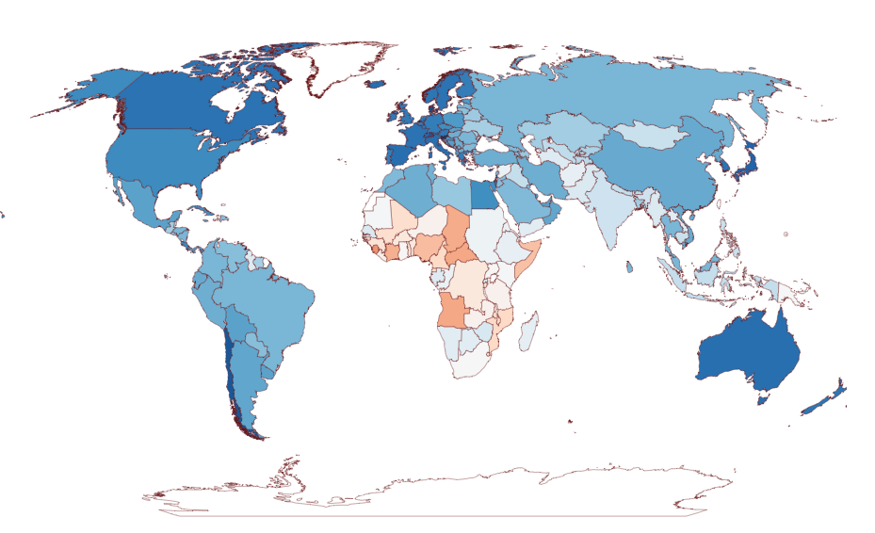
Life Expectancy in the year 2000
in years

Slide 9
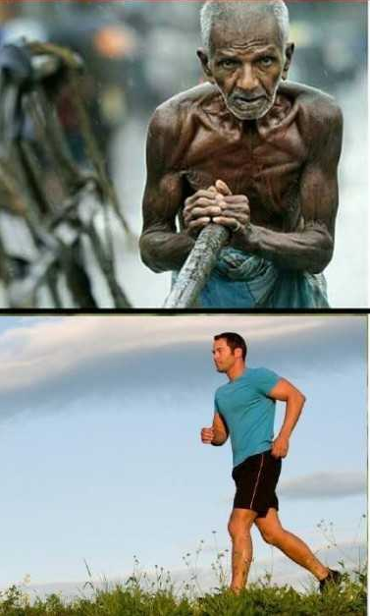
Motivation
Big difference between the countries
What features play a major role in this difference?
Overall increasing life expectancy from 2000 to 2015
How can we keep it up?
How can the lower life exp. countries do better?

Slide 10

Difference

Slide 11
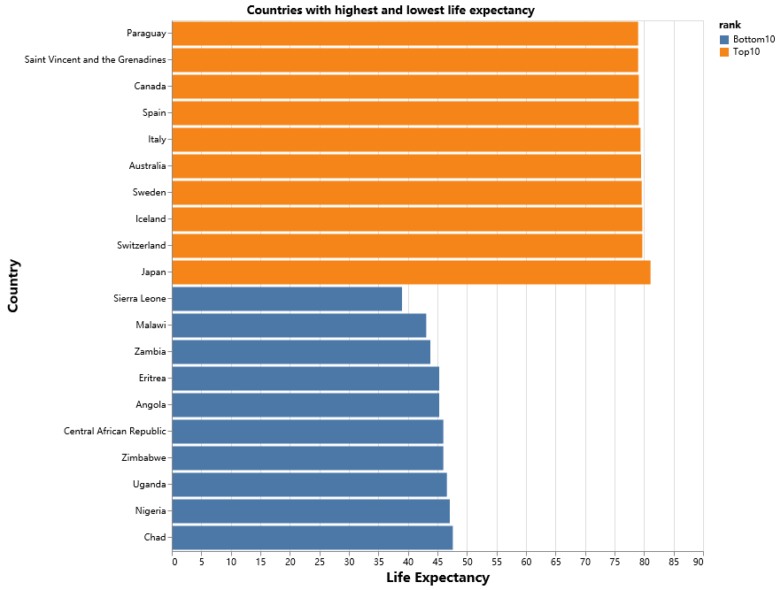
The huge gap in our world
The Top and Bottom 10
People in the Top 10 countries averagely live 40 years longer than the bottom 10.
In 2000, Japan had a life expectancy twice larger than that of Sierra Leone

Slide 12
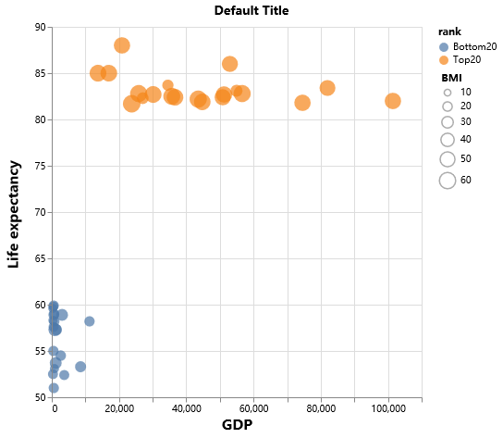
What creates this gap?
Top and Bottom 20
GDP per capita has a clear effect on the difference between them
Interesting observation: BMI of 24 is considered healthy, bottom 20 countries are closer to this number
This may be related to lack of enough nutrition in low GDP countries

Slide 13
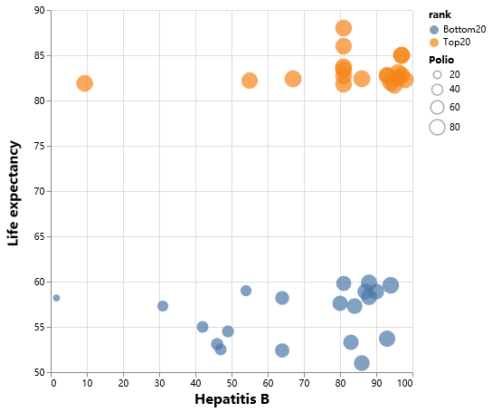
What creates this gap?
Despite similar coverage of important vaccines, poor countries are still suffering
Relevance is harder to assess in this situation
We need a better method to decide on the relevance of each feature

Slide 14
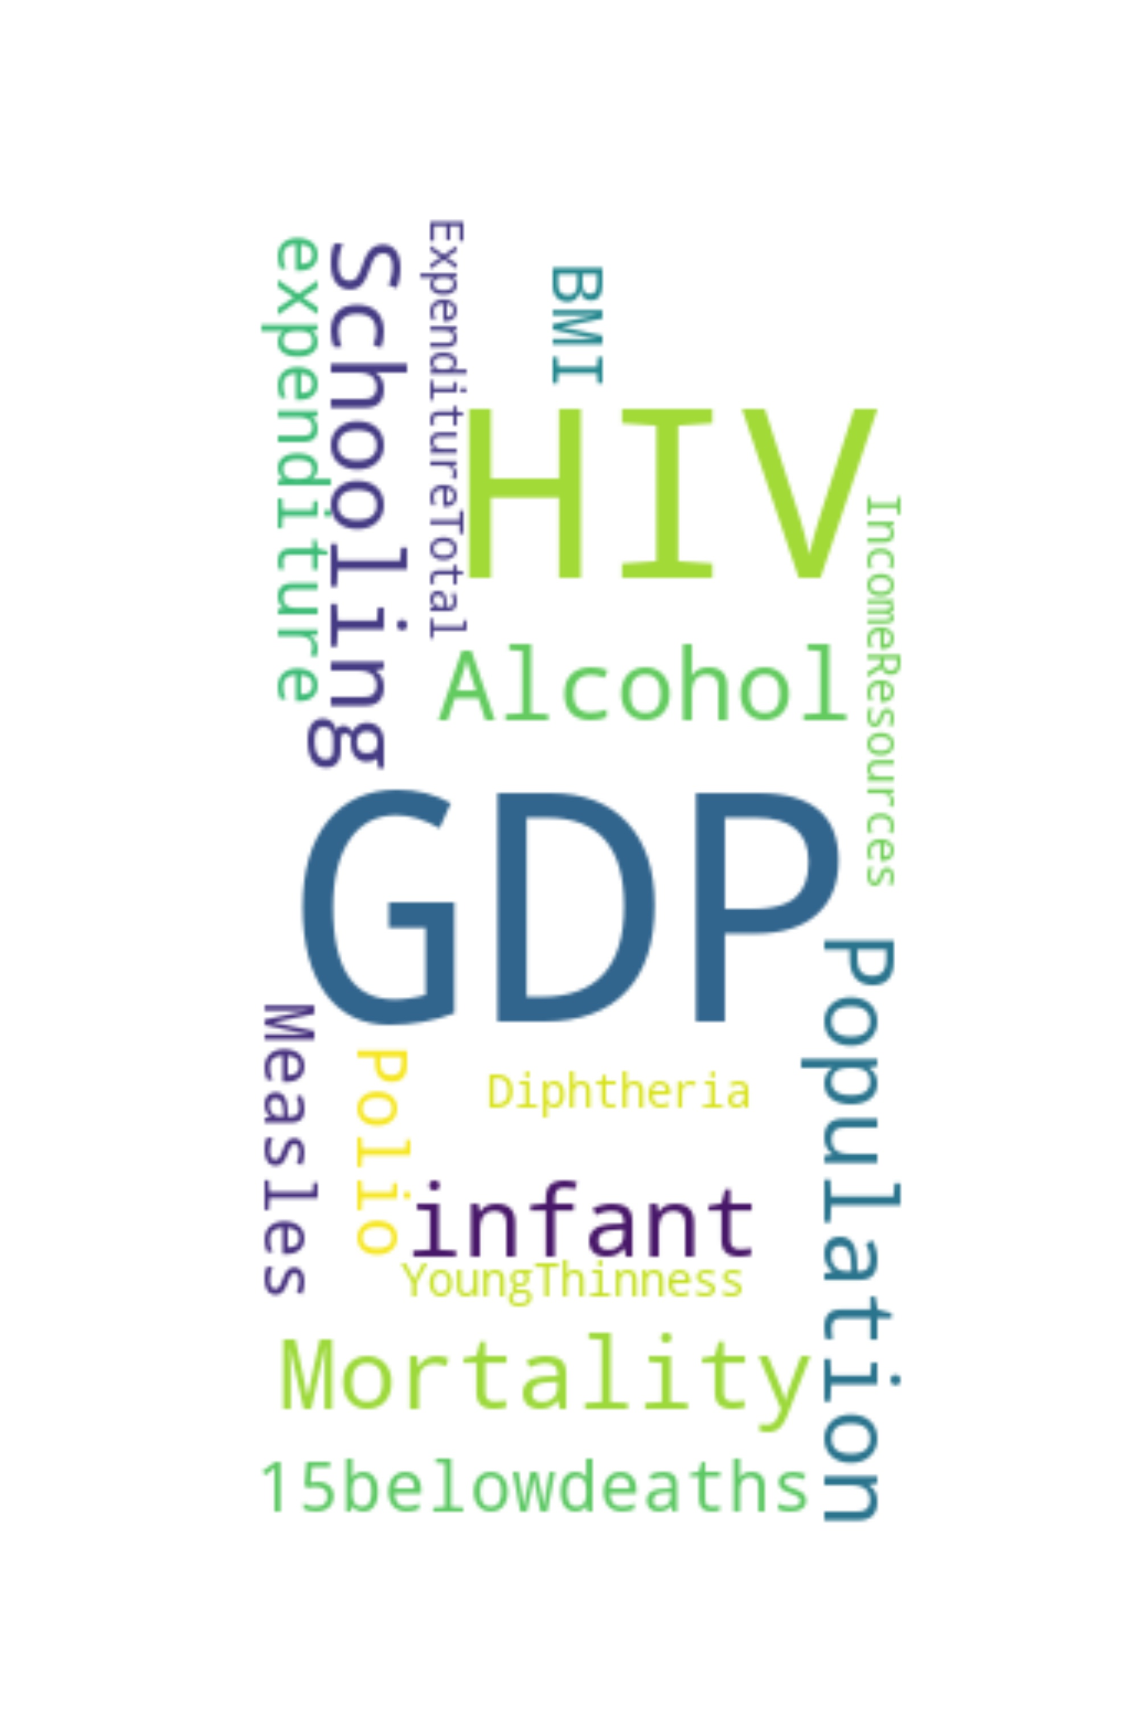
Relevance
Analysis

Slide 15


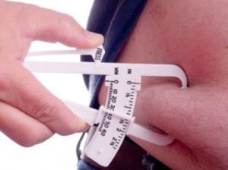
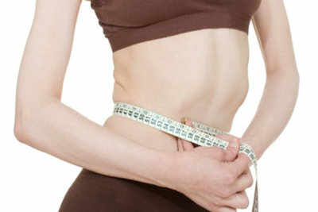
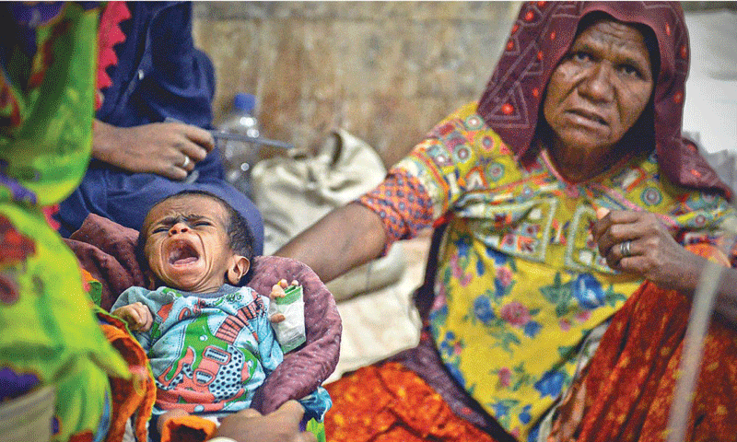

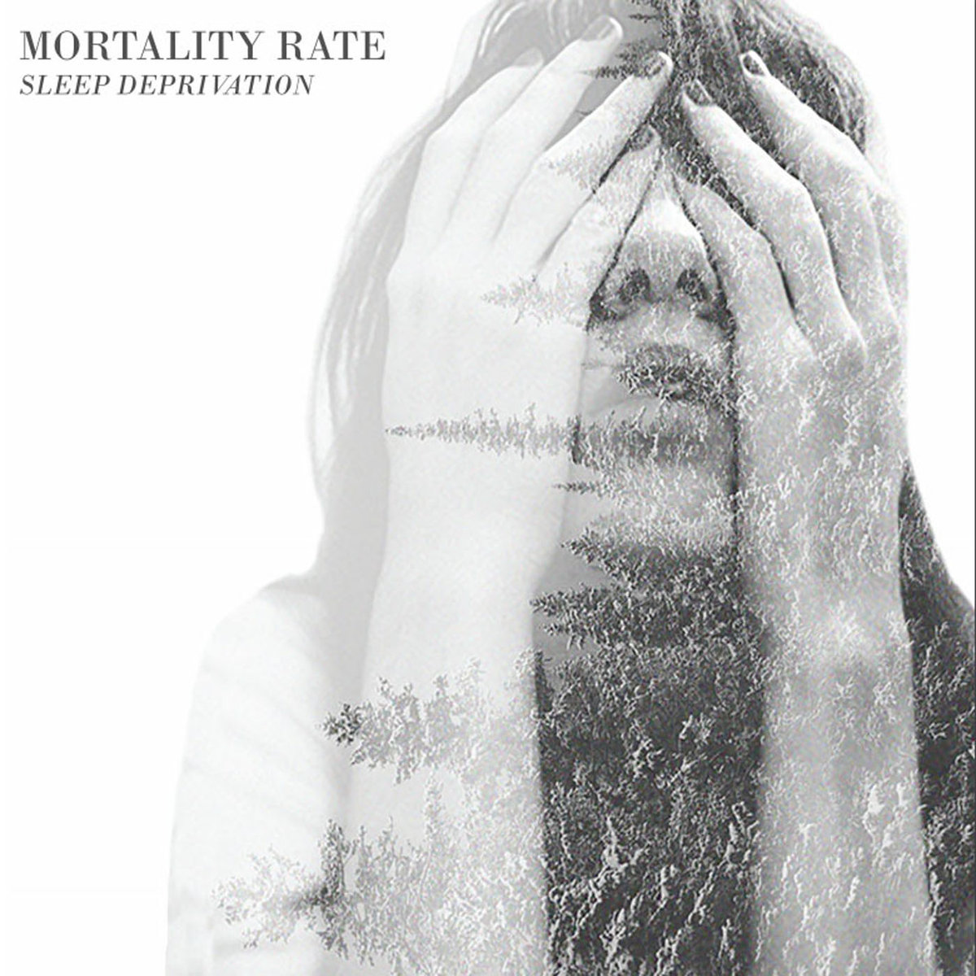



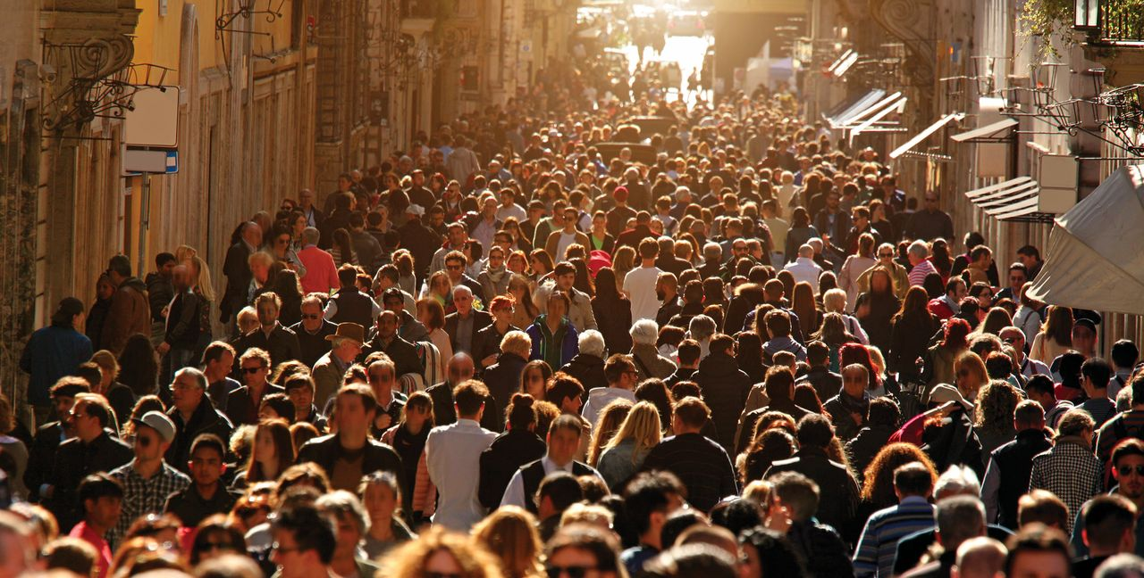


19 Features
 

Slide 16
Principal Component Analysis
Goal
Select the most relevant features
Make more accurate statements
6 most relevant Features:
GDP
HIV
Hepatitis B
Adult Mortality
Income comp. index
Schooling (may be tied to GDP)

Slide 17
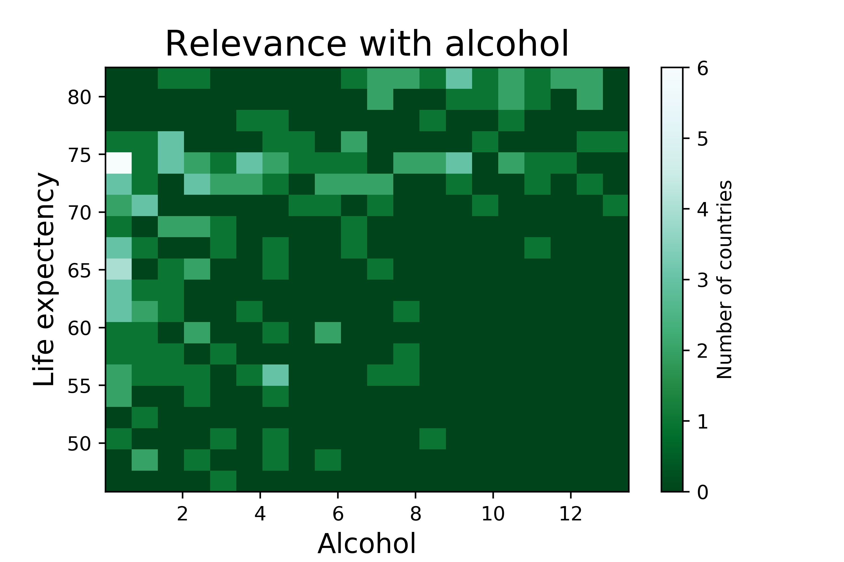
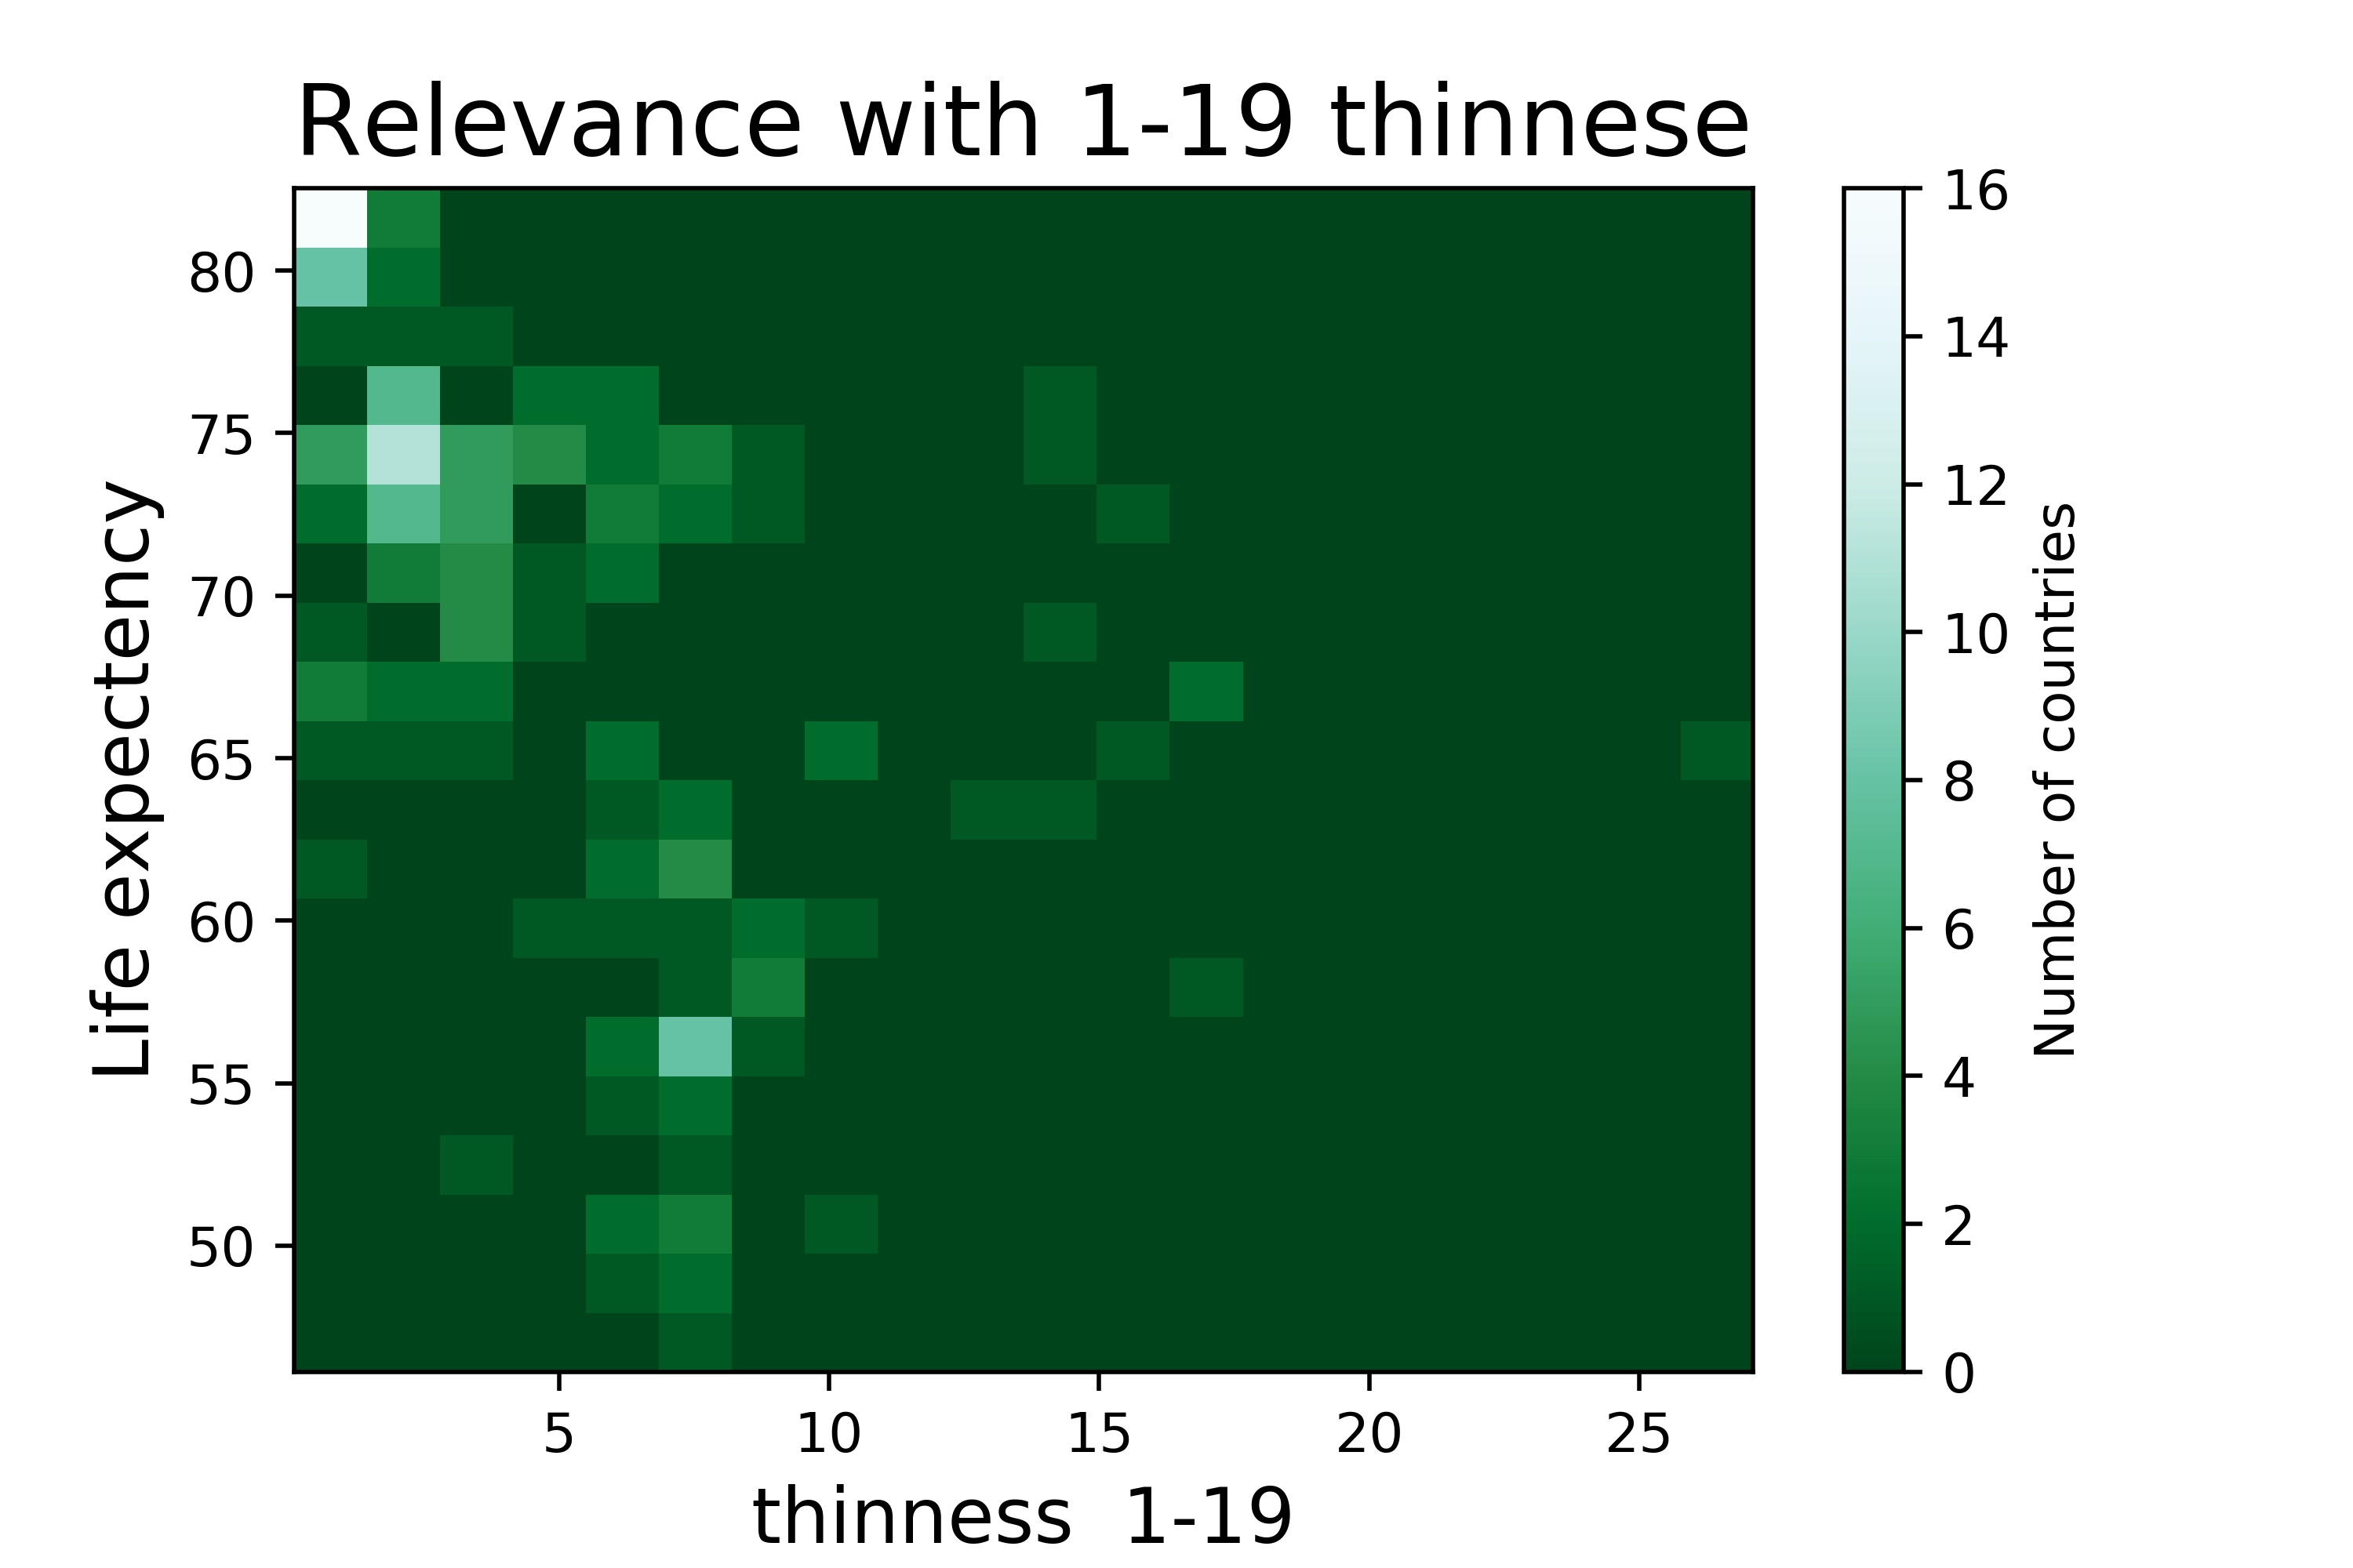
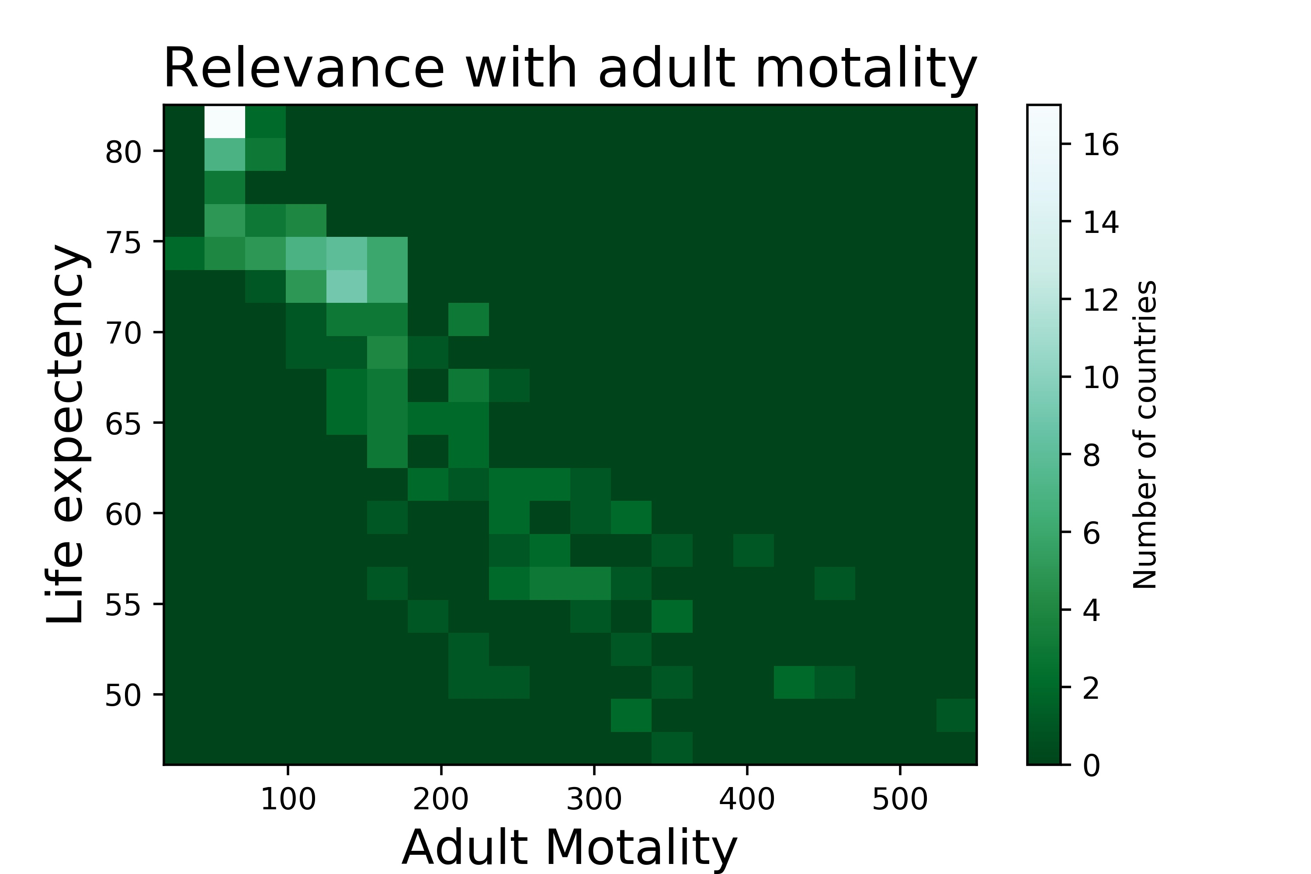
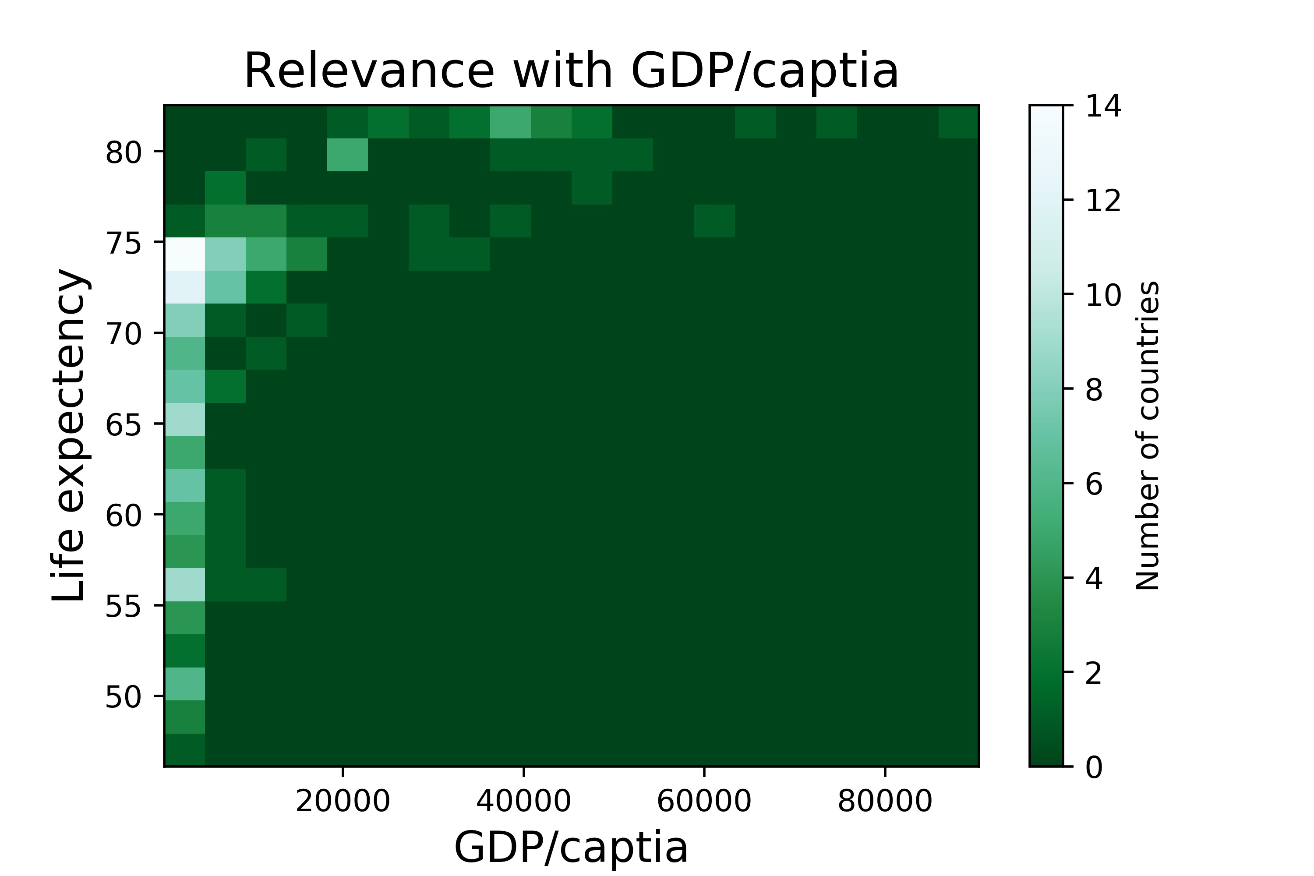
PCA
Lower Correlation
Higher Correlation

Slide 18
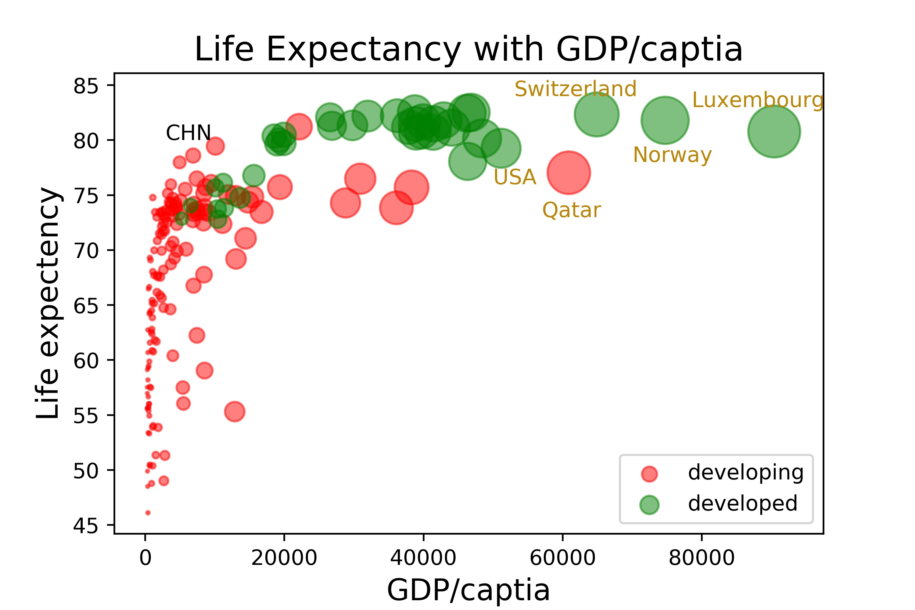
Life Expectancy vs GDP
Larger spots, higher GDP/capita
Life expectancy clearly positively relevant with GDP per capita and development status
A negative, decaying exponential distribution. Fast increase in the beginning, very stable for the later stages.
Northern Europe and USA
Developing countries

Slide 19
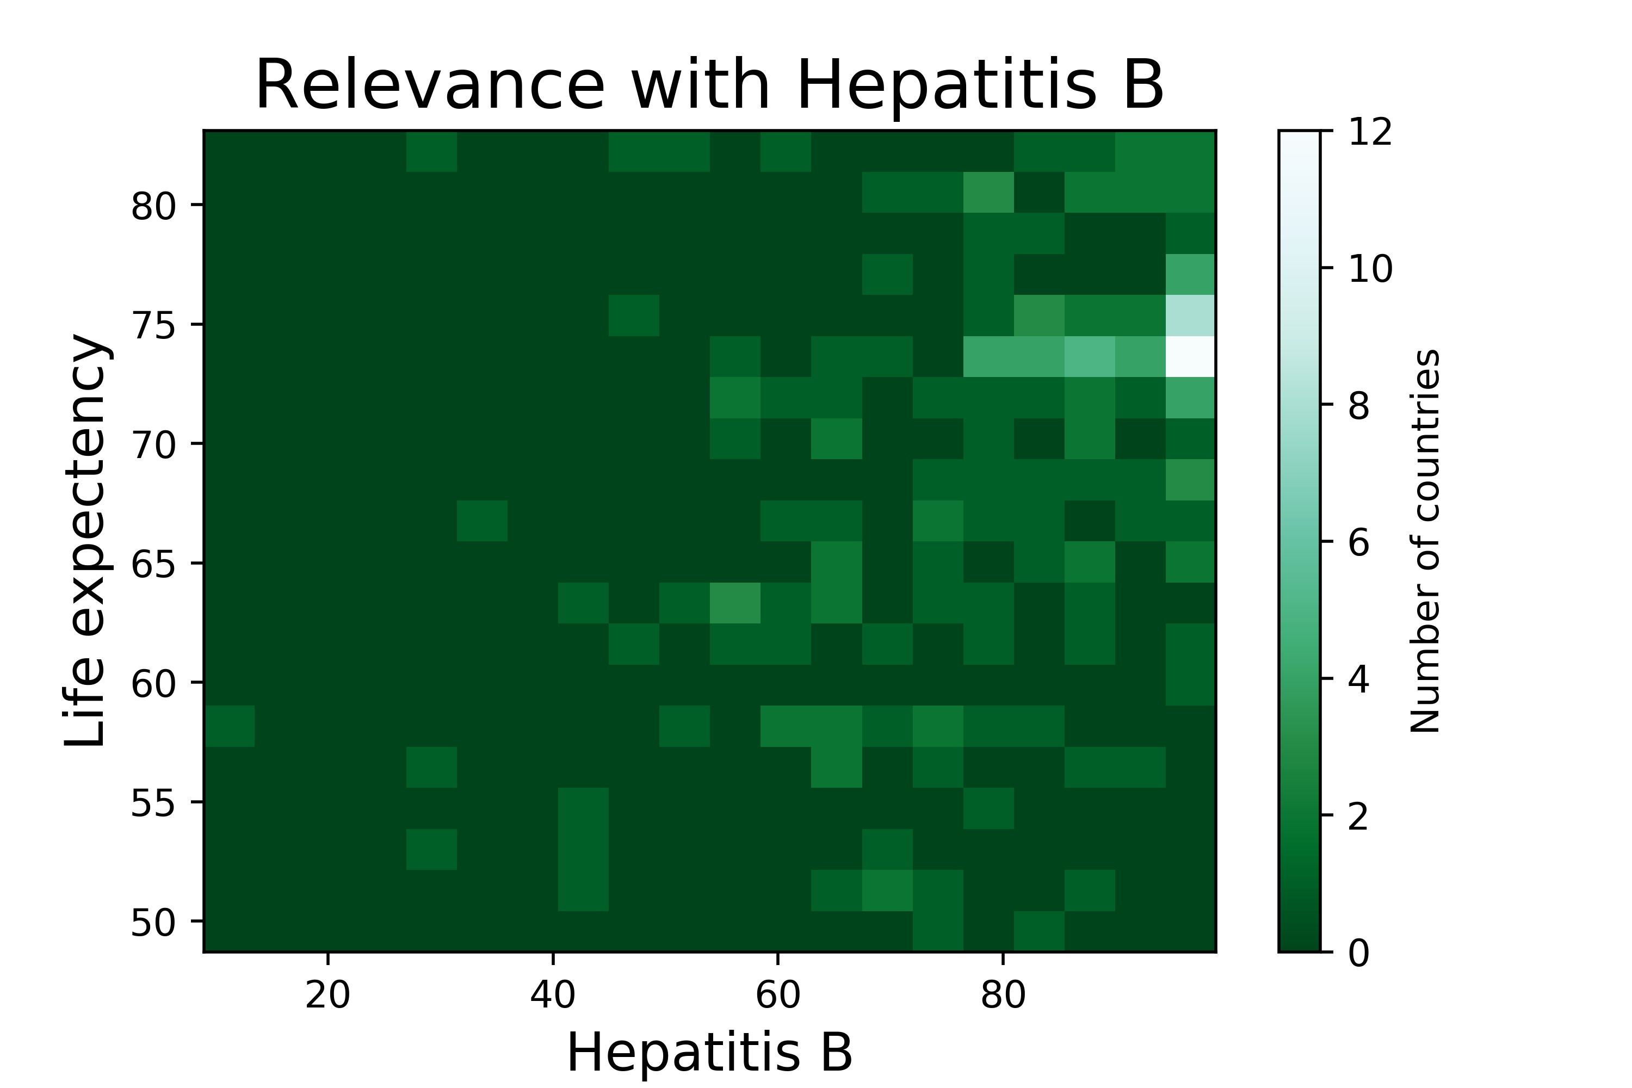
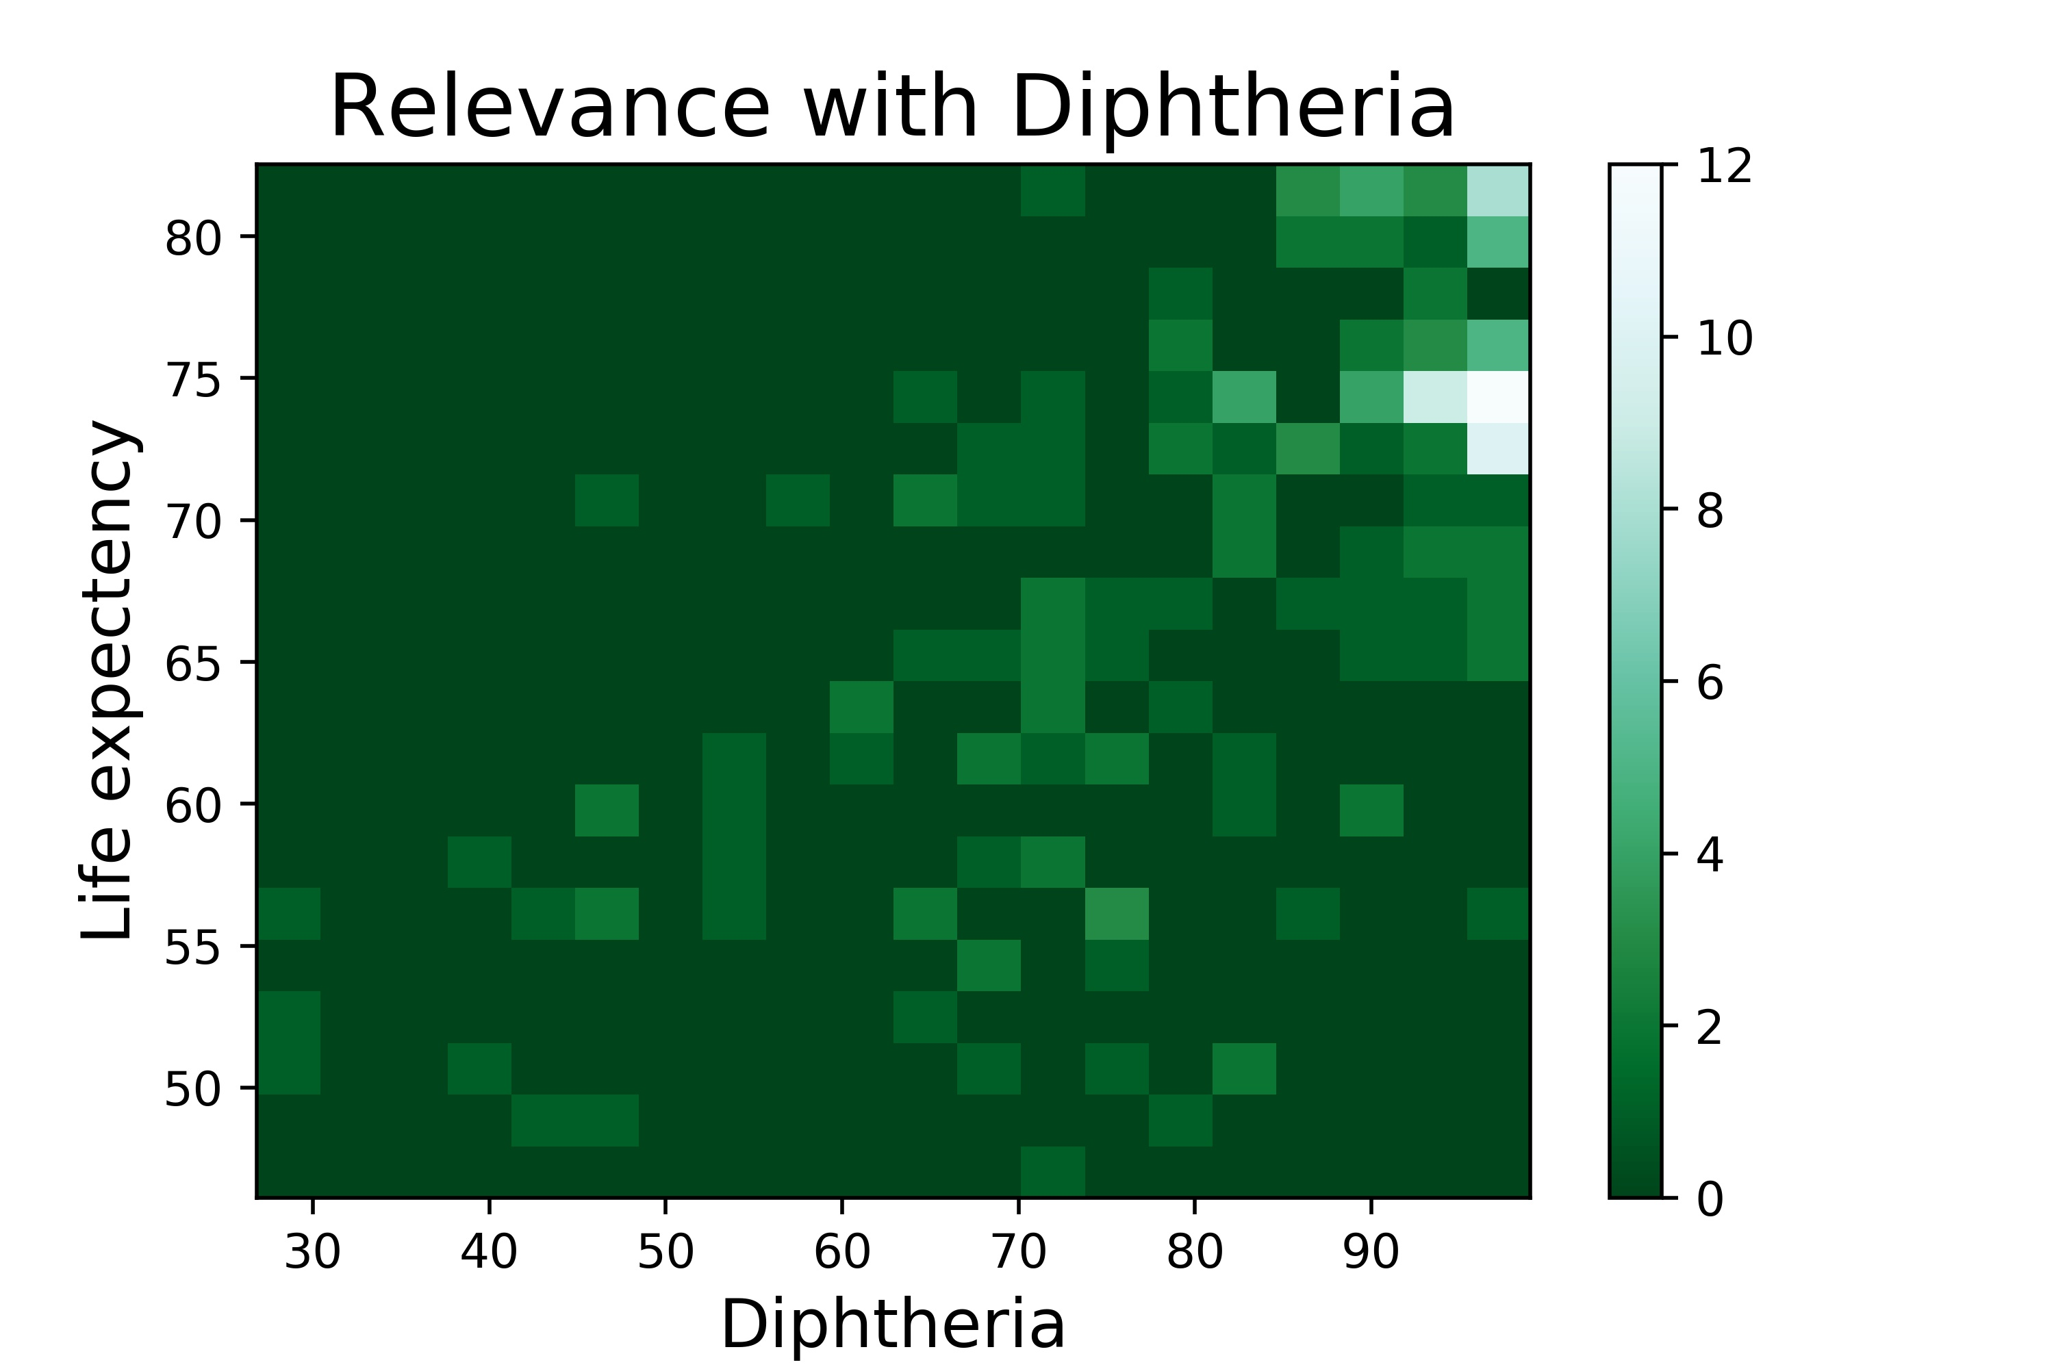
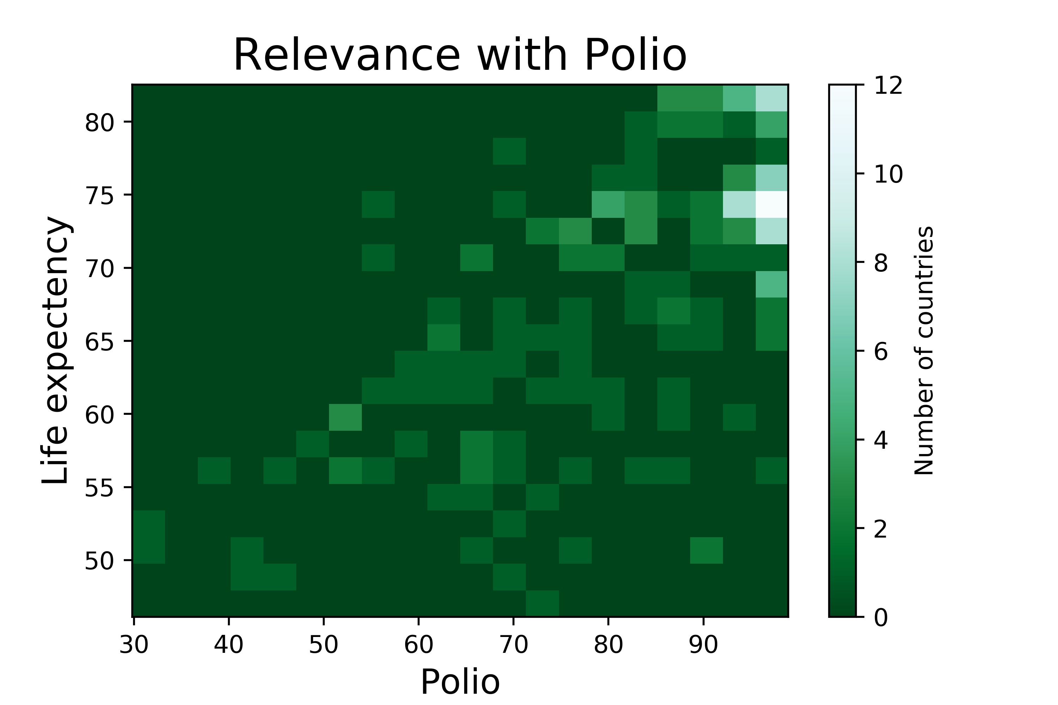
Positively related to life exp, but the correlation is not too strong
All the vaccines show a similar distribution when compared with life exp.
Features such as GDP, adult mortality had stronger correlation
Vaccines

Slide 20

Change
through the
years

Slide 21
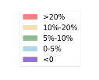

Slide 22
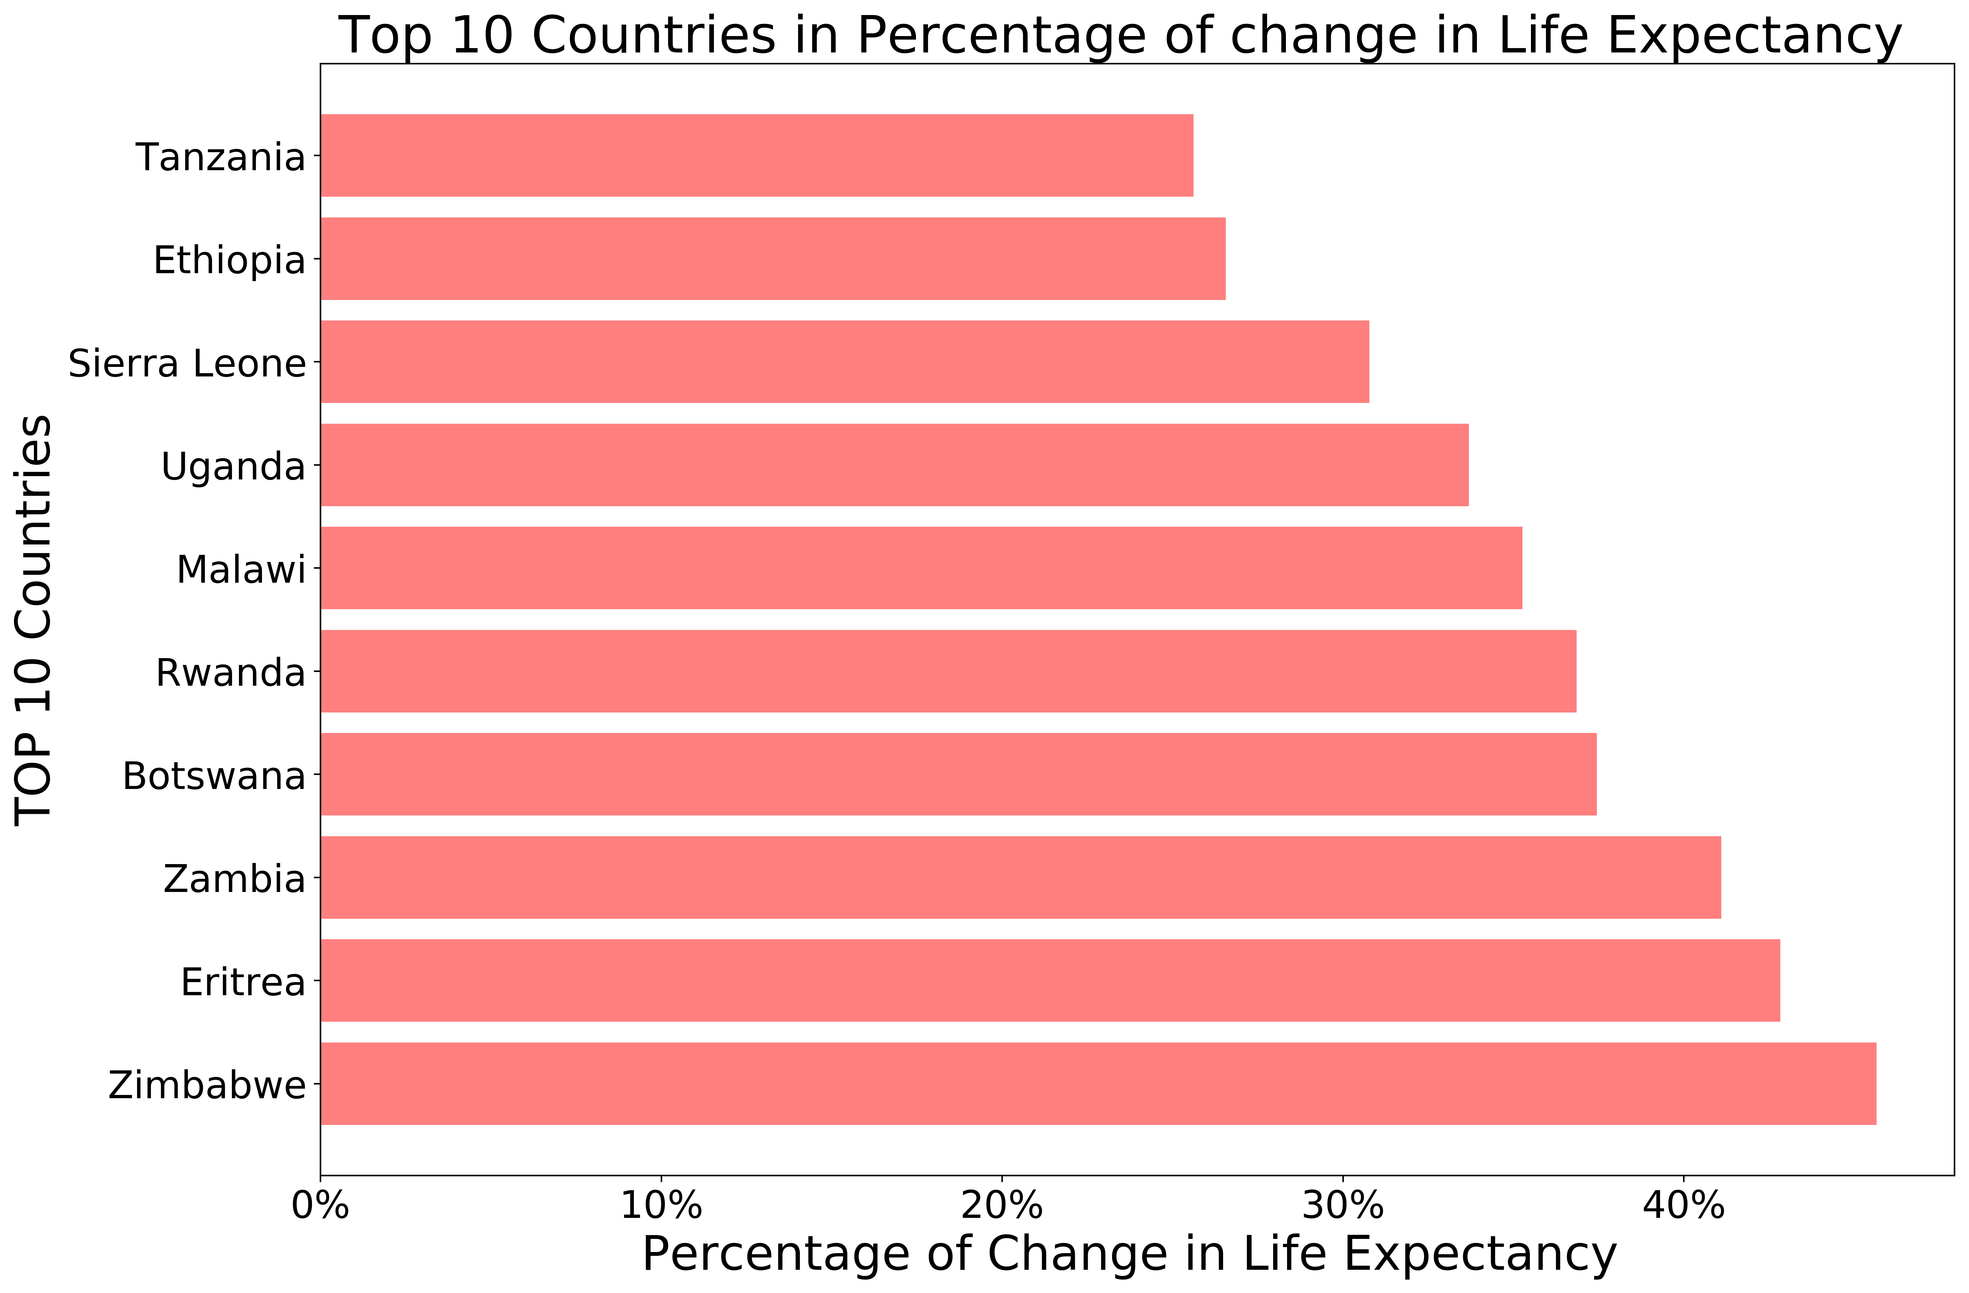
Mostly located in Africa.
Have higher than %25 percent change in life expectancy
Zimbabwe had more than 45% increase
Great change is possible

Slide 24
Ratio: 2.11
Ratio: 2.05
Ratio: 3.89

Slide 25
Conclusion

Slide 26
Conclusion
1. In general, features that affected life exp. most were GPD, Adult Mortality, HIV, Hepitatis B Vaccine
2. Countries that want to rapidly increase their life expectancy should focus on: HIV, income composition index and adult mortality
3. More research about underlying relations between the features, especially for GDP per capita vs others

Slide 27
THANK YOU

